Slide 1



SPORTS
FACILITY
DESIGN
SERVICES

Slide 2


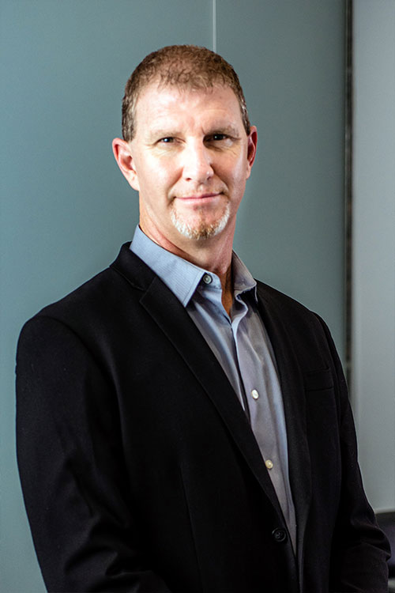
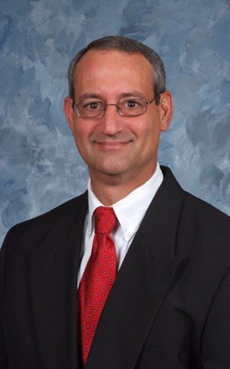
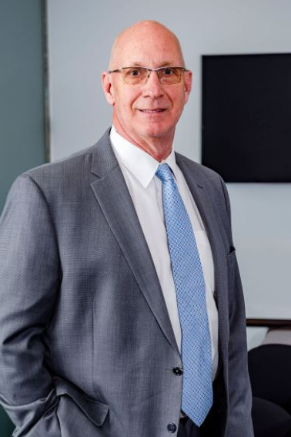
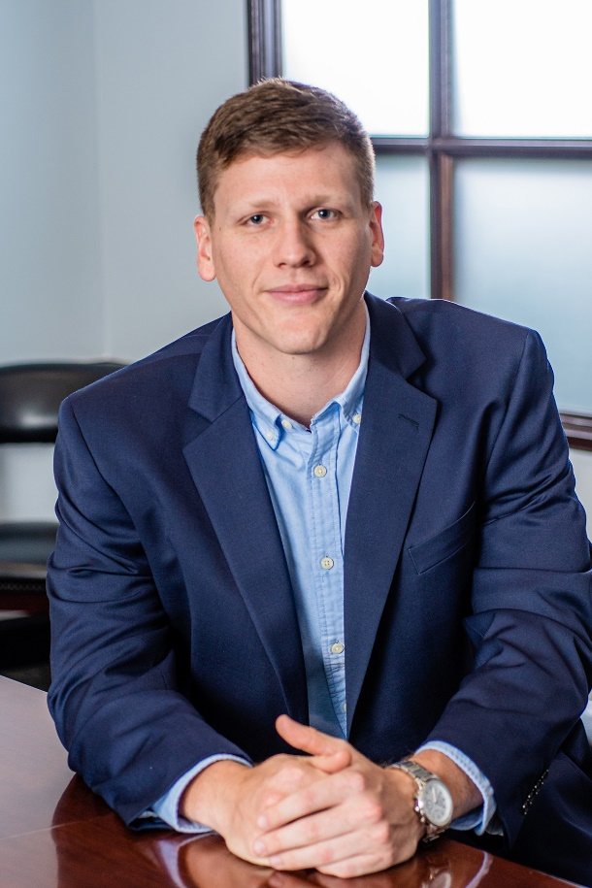
Sports Engineering Makes the Difference
Jeff Bresee, PE
Sports Division Team Leader/Engineer
John Valastro
Superintendent Consultant and Business Development
Richard Scoggin
Athletic Director and Project Management
Chance Hawkins
Design Specialist/Engineer

Slide 3
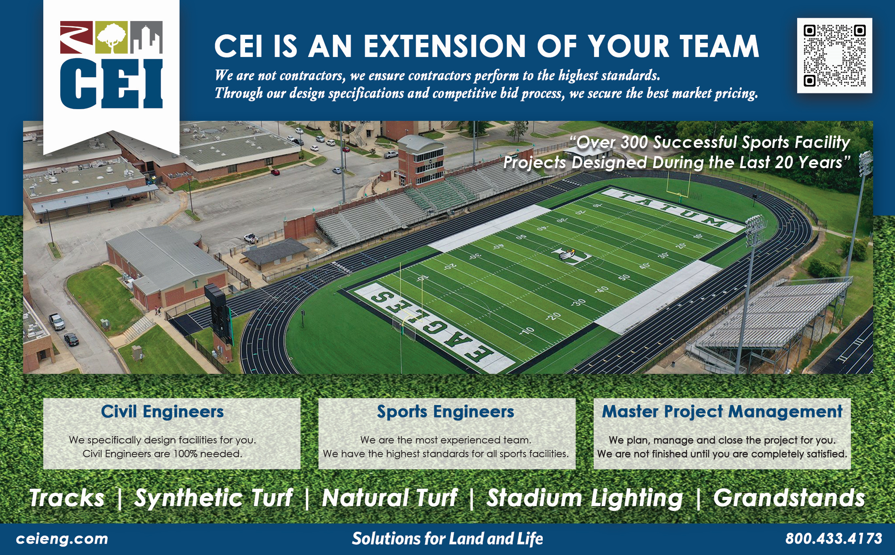

Slide 4
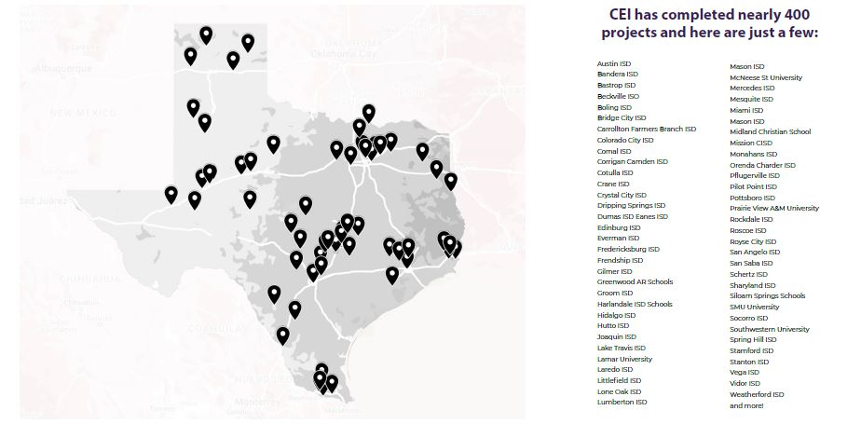
Sports Engineering Makes the Difference

Slide 5
Turf Project Team/Approach
- Sports Engineering Makes the Difference
The design work involved with outdoor sport facility projects falls specifically under the discipline of Civil Engineering. However, typical Civil Engineering standards and practices are not enough. These projects require specific engineering experience in Sports Facility Design or what we call “Sports Engineering.”
The uniqueness of outdoor sports facilities, together with the expectation of perfection that they carry, mandate that the design team have extensive and specific experience with the type of project. CEI is the only Civil Engineering firm in the State of Texas that offers this unique combination (both Civil and Sports Engineering), having vast experience in each. In both disciplines of engineering, we continually strive to be the most experienced and qualified Consultants. We do this by empowering our Sports Facility Team (made up of Civil Engineers, Designers, and Managers) to dedicate all of their time to the outdoor sports facility industry. Year after year and project after project, this team grows its database of design standards specific to outdoor sports facility projects. This enables them to provide time-proven design techniques, standards, principals, and practices that ensure competitive pricing and top-end/long-term quality. Additionally, their consistency and longevity in the industry have resulted in strong working relationships with the contractors and manufacturers that provide goods and services to the Sports Industry. In summary, this team is uniquely qualified to guide the Client in all aspects of a project, from conceptual planning and cost estimating until the final close-out.

Slide 6
Turf Project Team/Approach
- Sports Engineering Makes the Difference
During the Planning Phase of a project, our Sports Facility Team works personally with the Client to create concept plans and budgets that consider all options and controlling criteria. This sets the project off on the right foot by reducing the unknowns and making a solid plan forward. During the Design Phase, our team works closely with the Client to capture expectations while ensuring quality by using their vast industry knowledge to create thorough and reliable construction drawings, specifications, and proposal documents that are performance-based (no one Contractor or Vendor is favored). This creates an optimized proposal environment to ensure the best possible pricing while protecting quality. During the Construction Phase, the team works continually to ensure that the Client’s interests and expectations are met as they manage the project, conduct weekly progress meetings, provide weekly observations of the work, and in every way, work with the Contractor and Client to make sure the drawings and specifications are strictly followed. The Client can rest assured.
Throughout the project, Jeff Bresee, PE, will lead the Sports Facility Team and will be the direct point of contact for the Client. Jeff will be supported by Kevin Hall as the project Land Survey Manager, Chance Hawkins as the project Design Manager, Andrew Slyter as the project Technical Engineer, and Richard Scoggin as the Project Construction Manager.

Slide 7
CEI is Confident and Pledges:
We secure the best market price for your project
Our designs are proven to withstand extreme environmental conditions
We managed the project to stay on time and on budget
Fulfill expectations that facilities will last
We mediate on behalf of the district if problems arise

Slide 8
Sports Engineering Makes the Difference

